Slide 1
Intro to Web Front Ends
SWEN-610 Foundations of Software Engineering

Slide 2
Web front ends have a LOT of pieces
Highly subject to trends
Tons engineering challenges:
Usability
Compatibility
Performance
Accessibility
Key design concepts for web
Separation of style and substance
Reduce the user’s memory load
Semantic markup
Key pieces & vocab:
HTML: the initial structure of the page hypertext markup language
CSS: the style of page cascading stylesheets
JS: the logic of the page javascript
DOM: the current structure of the page document object model
The standards have evolved over time (since 1990s)
HTML is not a strictly defined syntax and browsers have accommodated many sloppy practices to avoid pages from ‘breaking’
There is so much legacy, attempts to clean up the syntax (e.g. XHTML) failed miserably!
Instead, there has been a consolidation over time of ‘winning’ browsers (although HTML 5 has also helped)

Slide 3
It’s all about the DOM
A webpage is a document. It’s content is a giant tree-like data structure
<foo bar=”baz”>content</foo>
Tags and Attributes
Tags are labels defining the type of data they enclose
<div></div> … just a placeholder. Division or divider
<input></input> … as it says, some type of ‘control’ that allows input
Many types: button, text, …
<table><row><column></column></row></table> … a grid (i.e. table)
NOTE: Tags have opening and closing marks
<input> (Open) </input> (close)
This provides structure and the ability for clients (like browsers) to parse the tree!
Tags have modifiers
<input type=“text”></input>
<div style=“border: 1px”></div>
https://developer.mozilla.org/en-US/docs/Web/HTML
https://www.w3schools.com/html/

Slide 4
It’s all about the DOM
Client
Client ( Browser) sends a request to retrieve (GET) a web page
Server handles the request, and the Browser receives HTTP response in HTML
HTML provides the initial structure of the DOM
Various things then concurrently modify DOM
<img src=”foo.png”> “go get (i.e. make HTTP GET request) for foo.png”
<script src=”foo.js”> “go get foo.js, then execute it”
<link rel=”stylesheet” href=”foo.css”>
go get foo.css and apply those styles to the DOM
Key: what order do these get executed in?
Usually… in document order, sort of …
CSS gets applied strictly in document order, JS not so much
HTTP Response ok (200)
<HTML> … </HTML>
GET http://server.com/index.html
Server

Slide 5
How big can the DOM be?
Pretty big.
Try this. Go to any website, open the Javascript console and run this: document.getElementsByTagName('*').length
Some examples
se.rit.edu/~swen-344 240 elements
nytimes.com 1,286
rit.edu 2,178
new.google.com 3,253
stackoverflow.com 3,460
reddit.com 4,423
coronavirus.jhu.edu/map.html 12,714
There are many, many (many) tags and properties
A major part of your education needs to be becoming comfortable with finding information in documentation
Two good resources are:
https://developer.mozilla.org/en-US/docs/Web/HTML
https://www.w3schools.com/html/

Slide 6
What is a web page?
Metadata tags to identify the page
It’s a text document (usually .htm or .html extension)
Content is in a ‘tagged’ language (sections are marked with specific characters)
<myTag></myTag> //Open and close tags
Browsers read/ parse the tags and build the DOM and then render (display) the information following the interpretation of the tags
<!doctype html>
<html lang="en">
<head>
<meta charset="utf-8">
<title>Web Assignment 1</title>
<meta name="description" content="First web assignment">
<meta name="author" content="Kal Rabb">
<link rel="stylesheet" href="custom.css">
</head>
<body>
</body>
</html>
Actual display content

Slide 7
Basic HTML building blocks
<html> <!-- Identifies the language e.g. not XML. PS This is a comment --> <head> <!-- CSS, fonts, metadata, js, etc. Typically stuff that isn’t displayed--> </head> <body> <!-- The actual content --> <img src=”foo.png”> <!-- vast majority of tags today are divs; allow placement and styling blocks --> <div>block of content</div> <p> Some text content with <span>inline styling</span> </p> </body> </html> <!-- Closing tag-->

Slide 8
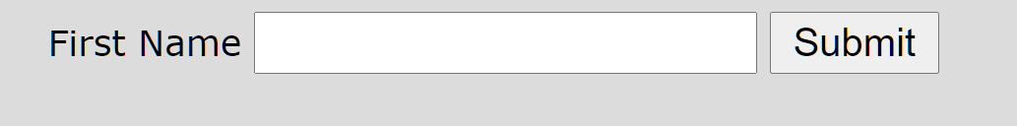
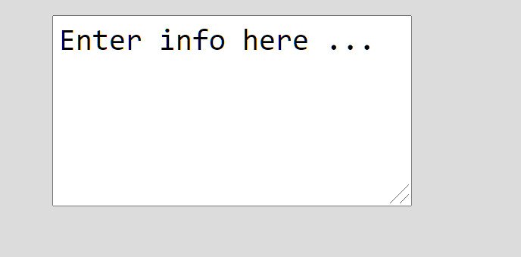

HTML Controls
<label>First Name</label>
<input type="text" name="firstname">
<input type="submit" name="send">
<textarea rows="5" columns="40" name="description">
Enter info here ...</textarea>
<input type="button" name="mybutton" value="clickme">

Slide 9
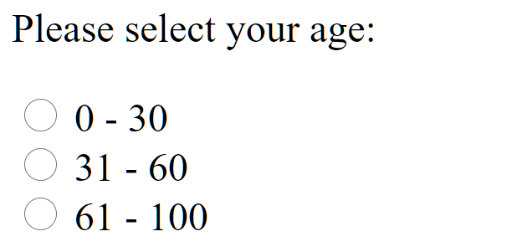
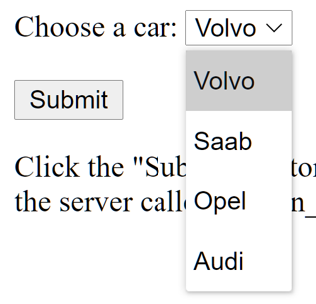
A few more …
<p>Please select your age:</p>
<input type="radio" id="age1" name="age" value="30">
<label for="age1">0 - 30</label><br>
<input type="radio" id="age2" name="age" value="60">
<label for="age2">31 - 60</label><br>
<input type="radio" id="age3" name="age" value="100">
<label for="age3">61 - 100</label><br><br>
<label for="cars">Choose a car:</label>
<select name="cars" id="cars">
<option value="volvo">Volvo</option>
<option value="saab">Saab</option>
<option value="mercedes">Mercedes</option>
<option value="audi">Audi</option>
</select>
https://www.w3schools.com/

Slide 10
Styles
All HTML elements can be styled
The style attribute specifies an inline style for an element.
The style attribute will override any style set globally, e.g. styles specified in the <style> tag or in an external style sheet.
<h1 style="color:blue;text-align:center">This is a header</h1>
<p style="color:green">This is a paragraph.</p>
This is a header
This is a paragraph.

Slide 11
Basic layout
‘display’ attribute (style=“display:<value>”)
There are two basic layouts defined with the display attribute
Block: A block-level element always starts on a new line, and the browsers automatically add some space (a margin) before and after the element. A block-level element always takes up the full width available (stretches out to the left and right as far as it can).
Two commonly used block elements are: <p> and <div>.
Inline: An inline element does not start on a new line. An inline element only takes up as much width as necessary.
<span>, <select>, <label> are common inline elements

Slide 12
HTML Forms
Initially, HTML was static information i.e. people wrote up articles, and other people would read (like a newspaper/ magazine)
In fact HTML (Markup) evolved from SGML (Standard General Markup Language) which was used for docments/ page and typesetting
However, data entry quickly became a need, and HTML extensions were added for user input and submission to the backend
i.e. HTML Forms (a way to standardize layout for input)
<form action="/my-endpoint" method="post"> <label for="name">Name:</label> <input type="text" id="name" name="user_name"> <label for="msg">Message:</label> <textarea id="msg" name="user_message"></textarea> </form>

Slide 13
Form submission
Forms provide a standard way of collecting information from a user, and sending the data back to the application (And this is the most common work you do when creating a web-page)
Typically, you would have a ‘Submit’ button
<input type="submit" value="Submit">
When this is clicked, the form will submit the form (send the data) based on the action tag
<form action="action_page.php" method=“POST" > [BTW, then does an auto ‘get’]
Note the ‘action’ can be to submit to any page (in this case a different page to navigate to), and you can (technically) POST or PUT or GET
However, you mostly will want to POST or PUT
Why? GET will put the data in the URL string (visible)
When you POST, the data is encoded in the body of the submitted form
Defaults to URL encoded (you can change it). But if you want JSON, you have to that on your own!
CAUTION: Default browser behaviour can be inconsistent – and not always what you want. Usually it is better to control the behaviour and NOT do an auto submit. Use a normal button and write JS to send the data to the server.

Slide 14
HTML Forms
<form action="/my-endpoint" method="post"> <label for="name">Name:</label> <input type="text" id="name" name="user_name"> <label for="msg">Message:</label> <textarea id="msg" name="user_message"></textarea>
<div>
<input type="submit" value="Submit Form" />
</div> </form>
“For” applies to the id of the input field within this form
Name applies to the data payload that you read on the server
Method is the HTTP method; The input button performs the Submit using POST
Also useful: <button/> <select><option><option></select> <legend/> <fieldset/> <input type=”checkbox”> <input type=”radio”> <input type=”email”> <input type=”search”> <input type=”tel”> <input type=”range”> <input type=”color”> <input type=”datetime-local”>

Slide 15
Many types of display
display: block
display: inline
display: inline-block
Width and height are respected
Content gets pushed away
But still treated in the flow of text
display: inherit
Just use what the parent element is using (good for resetting a theme default)
display: flex
display: float (left, right …)
display: grid
display: table
i.e. <table>

Slide 16
JavaScript (JS)
Interpreted language,
Just-in-time compiled
Garbage collected
Multi-paradigm
Has some OO, but no inheritance or encapsulation
Has lots of C-style procedural syntax
Functional programming influence
Prototype-based programming
Add properties and methods at runtime to another object, e.g. empty object
You can create an object without first creating a class
First-class functions
A function can be treated like any other variable
E.g. sayHello()
No concept of input or output - just modifying the host environment
function sayHello() { return "Hello, "; } function greeting(helloCallback, name){ console.log(helloCallback() + name); }
greeting(sayHello, "world!");

Slide 17
Use JS Events to …
Respond to user actions
A button click (onClick)
A radio button selection (onChange or onClick)
A listbox selection (onChange or onClick)
And then do something …
function myEventHandler()
{
//get the object
//Figure out which attribute you want to change
//Change it
}

Slide 18
A javascript teaser …
Javascript allows dynamic behaviour (change html on the fly) within the browser
You can add Javascript code to the <head> tag; or elsewhere in the body; simple function declaration and object syntax
<script language="javascript“ type=“text/javascript”>
function setText(id1)
{
obj1 = document.getElementById(id1); //Get an element (in the DOM)
obj1.value = “Some value”; //Different DOM objects have different attributes you can set
}
</script>
Javascript called (for example) on DOM events; ids are unique within a given page
<div id=‘anotherId’ onClick=setText(‘someId’)></div>
Or .text; .innerHTML; class; …
Or another event (e.g. onchange …)
MDN (https://developer.mozilla.org) and w3schools (https://www.w3schools.com/) are great resources

